Slide 1
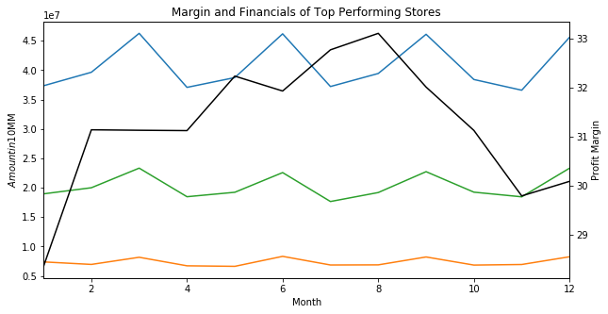
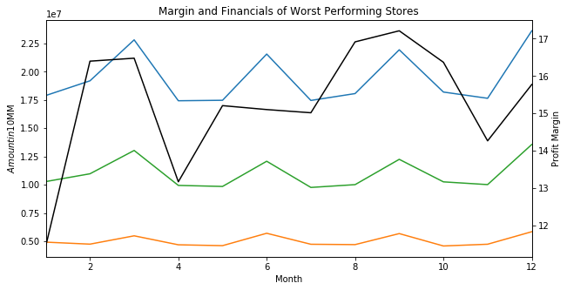
Locations in the top quartile of profit margin were able to overcome steep declines in revenue
Revenue and Cost trends vs. Profit Margin throughout the year
Profit Margin
Profit Margin
The above graph shows the profit margins vs revenue and costs for the top quartile of stores with the highest profit margin. These stores were unaffected by the revenue decline that happened in the first quarter
However, the bottom performing stores were clearly largely affected by the drop in Revenue. It took these stores 6 months to recover from such a drop
Correlations of Average Profit Margin each month across all stores (Months 1-5):
Correlations of Average Profit Margin each month across all stores (Months 1-5):
The top performing stores are negatively correlated with Fixed costs and slight positively correlated with Revenue in that time period
However, the worst performing stores were heavily correlated with Revenue suggesting the drop in revenue led to the significant drop in margin

